Slide 1


Laptop Price Prediction
Analyze and predict laptop prices using machine learning. This project uses a dataset of laptop specifications to predict prices. It is a linear regression task.
by Neha Rastogi

Slide 2

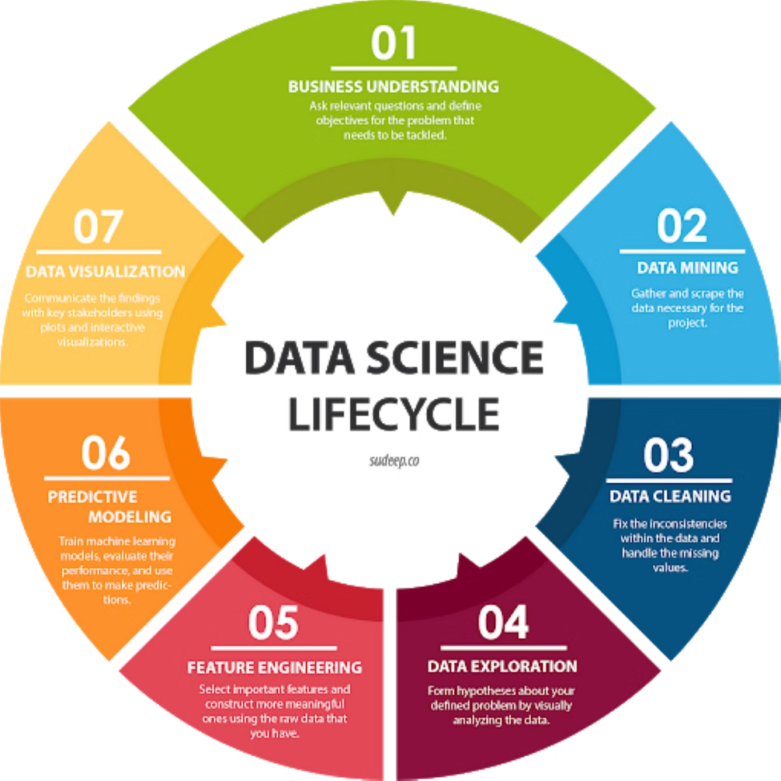
Project Steps
1
Problem Statement
2
Dataset
Build a model to predict laptop prices based on features.
Utilize laptop specifications like brand, RAM, and storage.
3
Model Training
Train a linear regression model.

Slide 3
Dataset Columns
Features
Target
Company: Manufacturer
Price_euros: Price in Euros
TypeName: Laptop Type
Other
Inches: Screen Size
Ram: Total RAM (GBs)
Weight: Laptop Weight (kg)
OS: Operating System
Screen: Screen Definition
CPU: CPU frequency
Primary and Secondary Storage
GPU Company
Touchscreen
IPSpanel
RetinaDisplay

Slide 4





Key Steps
Data Preprocessing
Convert categorical data to numerical data using One-Hot Encoding.
Train-Test Split
Evaluate the model on unseen data.
.
Feature Scaling
Feature scaling was performed using StandardScaler.
Performed to create the same scale for all variables.
Hence, all variables will have a similar influence on the model.
Linear Regression
Predict laptop price using features.

Slide 5
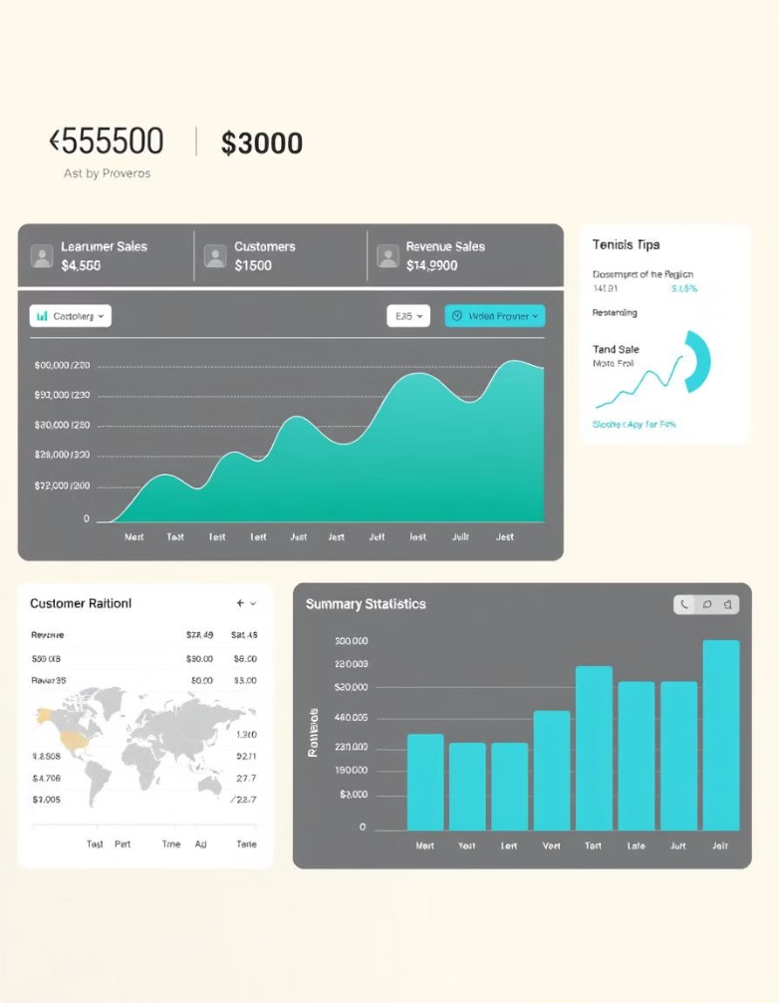
Exploratory Data Analysis
Shape
Data Types
The dataset contains 1275 entries and 23 columns.
Includes float64, int64, and object data types.
Missing Values
No null values were found in the dataset.

Slide 6
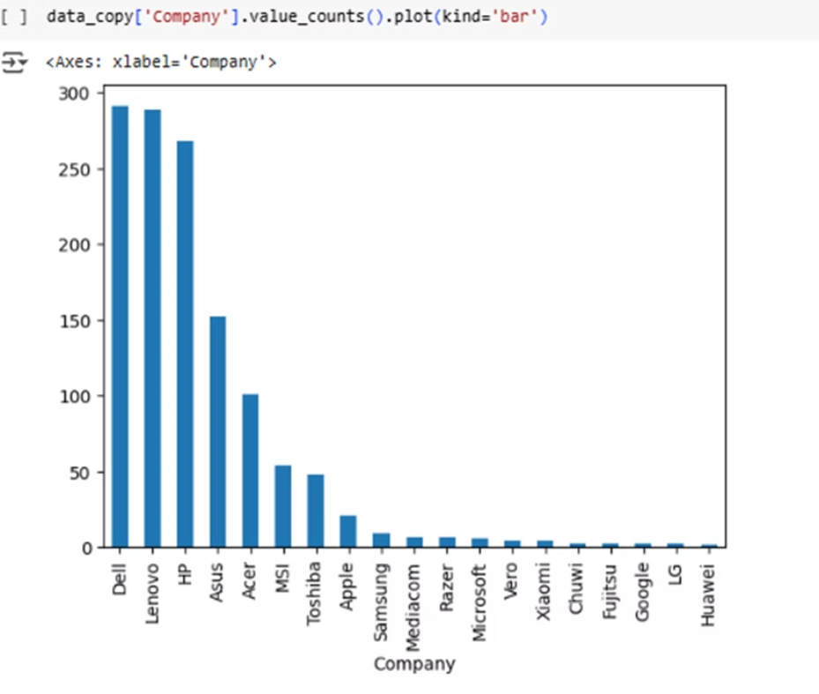
Data Visualization
Bar Plot on Distribution of Companies of Laptop.

Slide 7
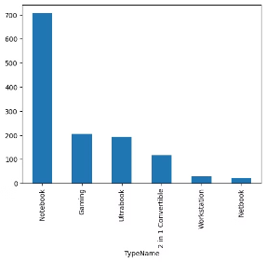
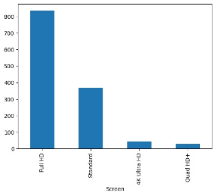
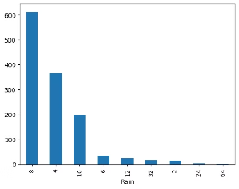
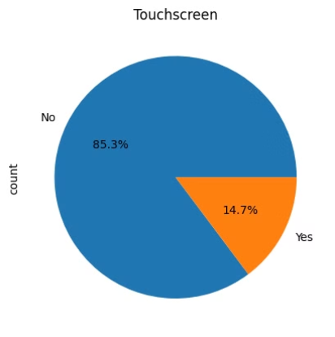
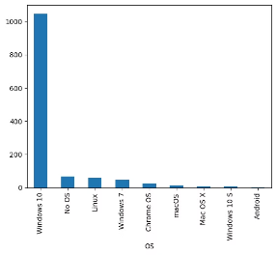
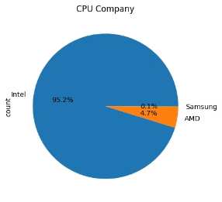
Detailed data visualizations depicting the relationships between different device specifications and their respective counts.

Slide 8
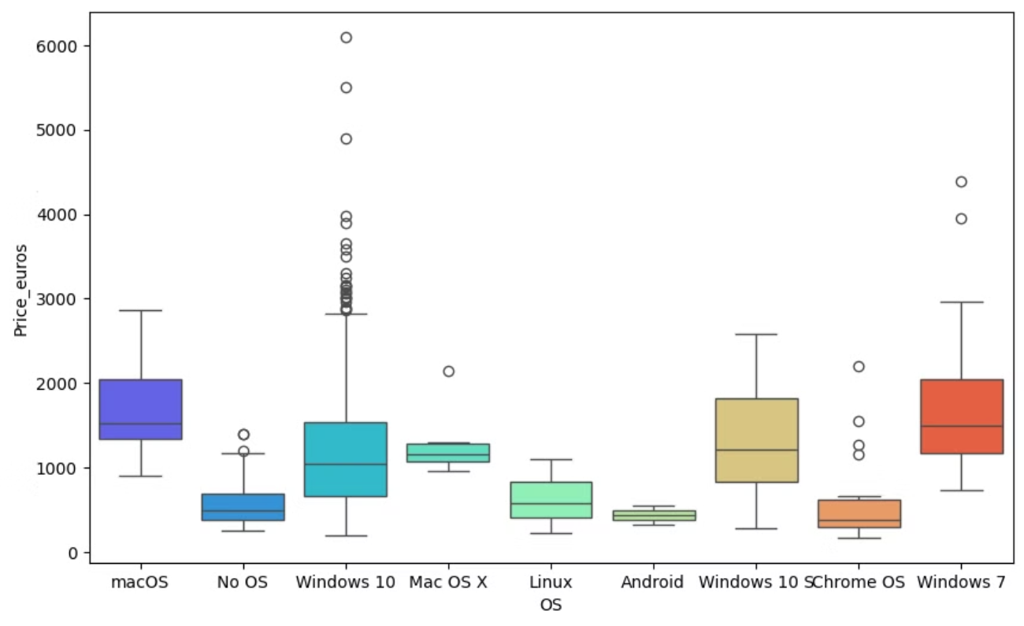
Distribution of OS vs. Price

Slide 9
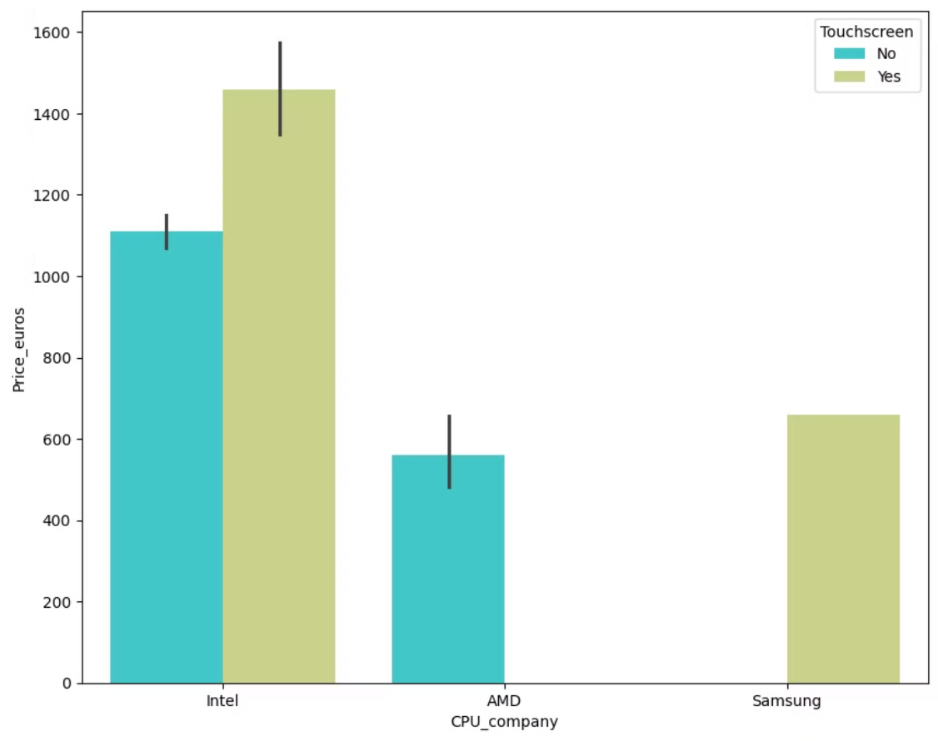
Distribution of CPU vs. Price

Slide 10
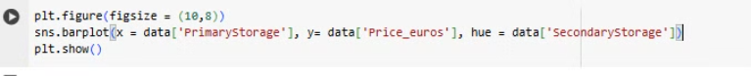
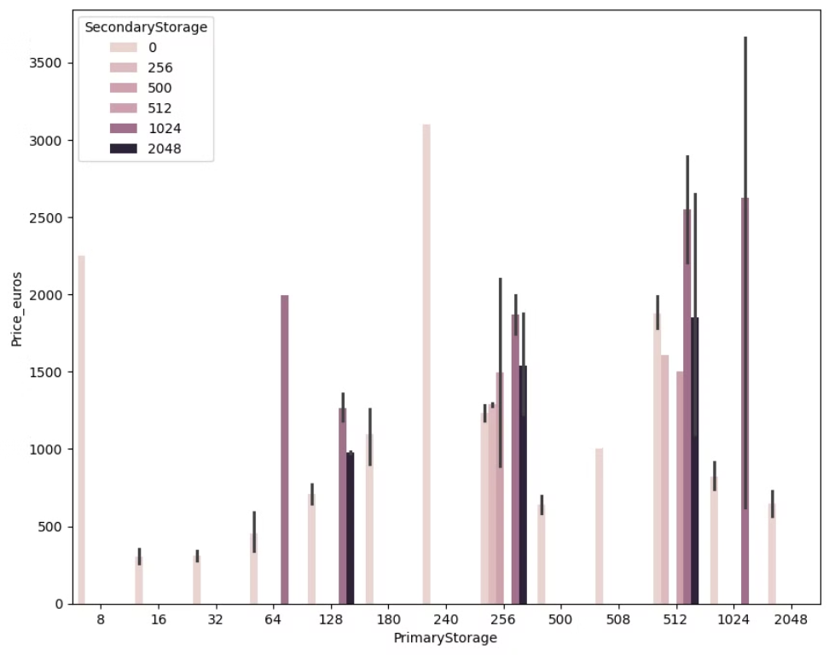
Distribution of Primary and Secondary storage vs. Price

Slide 11

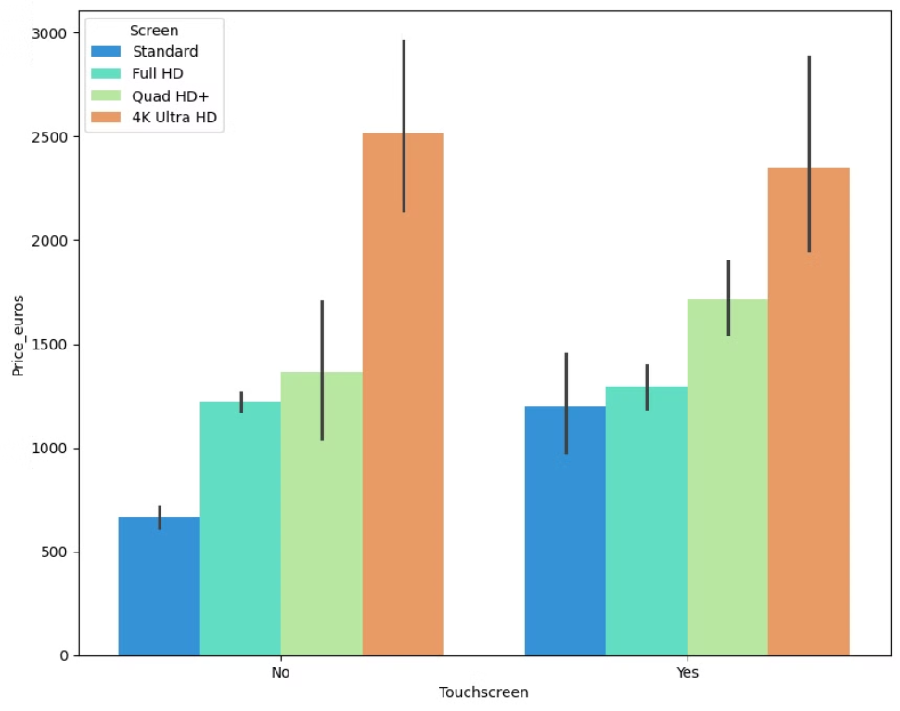
Distribution of Touchscreen and Screen vs. Price

Slide 12

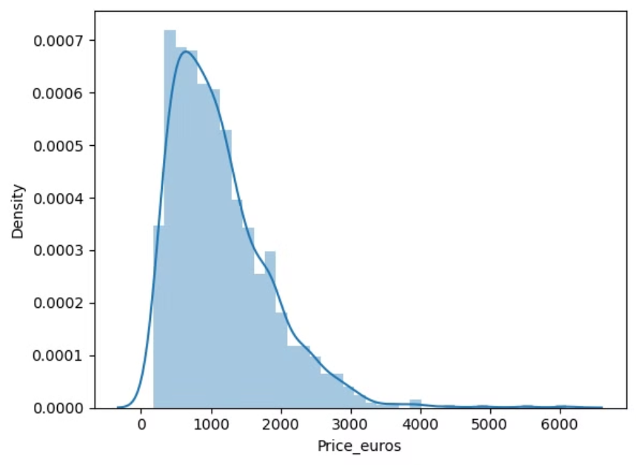
Distribution of Price (Target Variable)

Slide 13


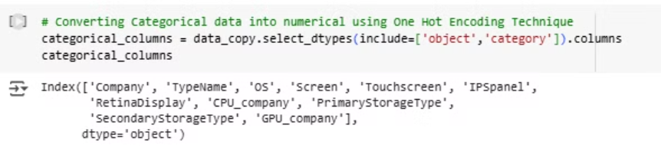

Data Preprocessing
Categorical data converted to numerical using One-Hot Encoding.
Columns like 'Product', 'CPU_model', and 'GPU_model' were dropped.
Feature scaling was performed using StandardScaler.

Slide 14
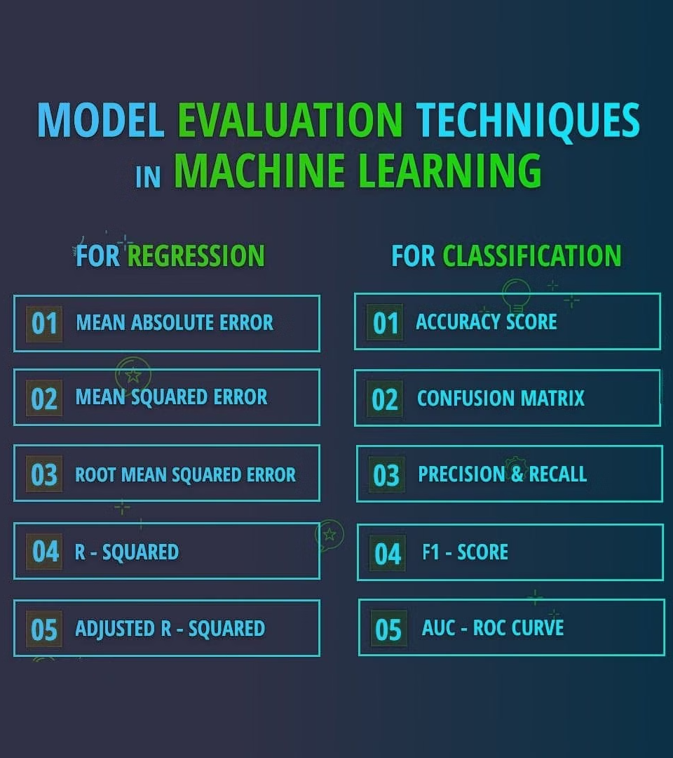
Model Training and Evaluation
116404
MSE
Mean Squared Error
0.76
R-squared
Coefficient of determination
Linear Regression model trained. R-squared: 0.76, meaning 76% of the variance in laptop price is predicted.

Slide 15

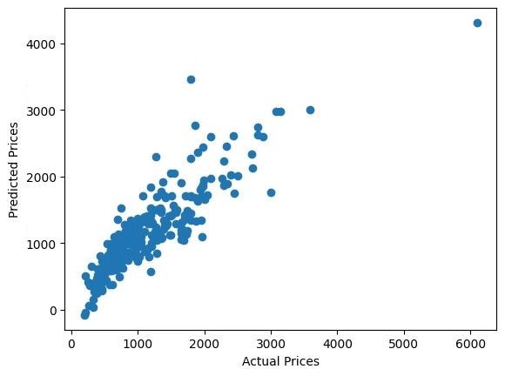
Actual vs. Predicted Prices
The model shows a good fit between actual and predicted prices.
76% of the variance in laptop price is predicted by independent variables.

